Slide 1

What is my neighbourhood like?
Read this if you want to learn:
Why statistical data about your local area is important
What statistical information is available for public use
How to find & present data about your local area using:
    Neighbourhood Statistics
    Nomisweb
Download simple maps showing local statistics
    Neighbourhood Statistics
    Deprivation Mapper

Slide 2
What’s in this presentation?
Why do you need local statistics? Slide 3
What statistical information can you get? Slides 4-6
Scales of geographical data Slide 7
Census data in Neighbourhood Statistics Slide 8
  Step 1: Finding data Slides 9-13
  Step 2: Downloading data to use in Excel Slides 14-16
  Step 3: Mapping local data Slides 17-19
Nomisweb Slides 20-25
Deprivation Mapper Slides 26-28
Other sources of statistical data Slide 29

Slide 3

Why do you need local statistics?
When developing your First Steps plan (and when applying to other funders) it is important to have good evidence of what your area is really like. Statistical information collected by various public bodies can be an excellent way of doing this.
Statistics may help you to:
Paint a clearer picture of your area
Highlight the scale of an issue
Identify which issues are most important to focus on
Track changes in your area over time

Slide 4
What statistical information can you get?
Census data
The Census is a questionnaire sent to all households in Britain once every 10 years. It features questions about who lives in a household, where they work, their education, health, religion and marital status, among a wide range of others. The most recent Census was conducted in 2011.
Individuals’ answers to Census questions are not available for the public to see as this is confidential information, but summary data can be downloaded for wider areas. This shows the total number or proportion of people within an area who fall into a particular category, e.g. retired, and for certain questions may show the average value for the area, e.g. median age.
Neighbourhood Statistics is probably the best source of Census data but for economic Census statistics NomisWeb is also useful. This guide will take you through how to use both of these data sources.

Slide 5
What statistical information can you get?
Benefit claimant data
NomisWeb also allows you to view statistics on the number of benefit claimants within an area. The main statistic used is the proportion of the local working age population who claim Jobseeker’s Allowance (JSA), which is an unemployment benefit individuals can claim while they are looking for work. This gives a good indication of unemployment in an area, although it is important to remember that not everyone who is unemployed necessarily claims JSA. This data is published every month, so is particularly useful for identifying trends or how an area is changing over time.

Slide 6
What statistical information can you get?
Indices of Multiple Deprivation
The Indices of Multiple Deprivation (IMD) show how deprived areas are by taking into account a wide range of factors. Scores are calculated using income levels, levels of employment, health and wellbeing, education and skills, barriers to housing and services, levels of crime and the quality of the living environment in the area.
For England, the IMD are published every five years, most recently in September 2015.
Deprivation Mapper, which is explained later in this presentation, is a relatively easy way of accessing and understanding the IMD.

Slide 7
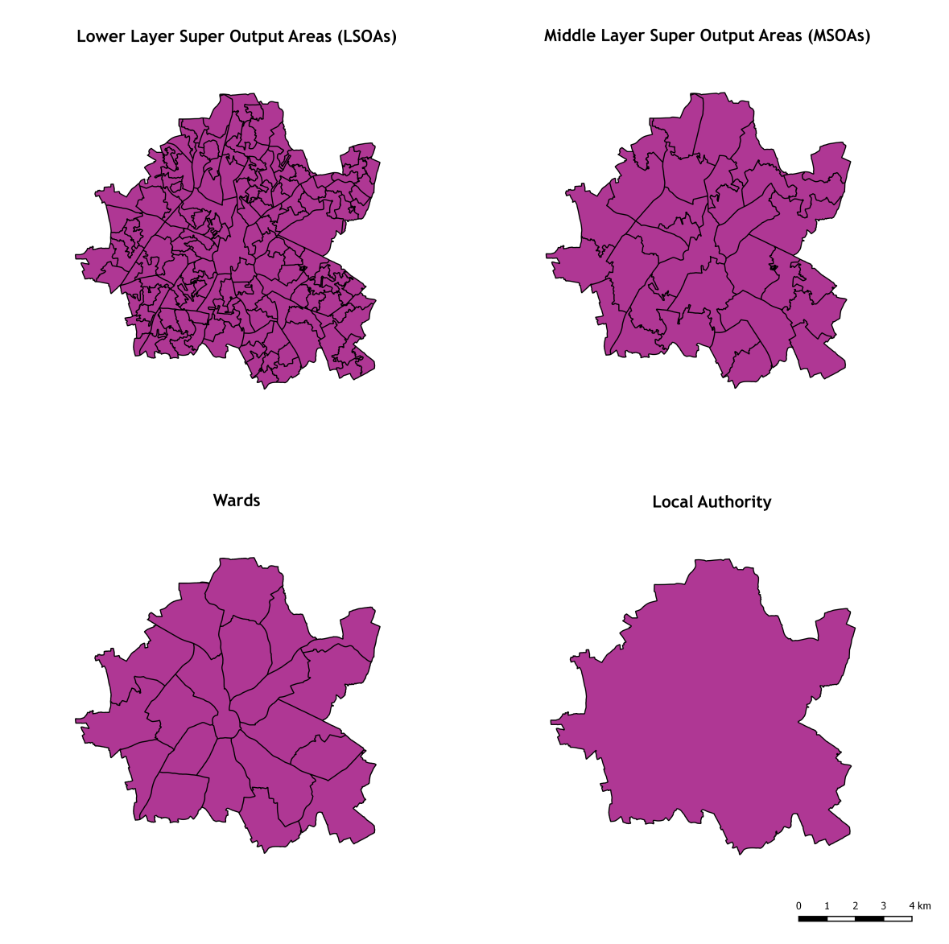
Scales of geographical data
Statistics tend to be available at four different geographical scales:
Local Authorities – the least detailed level available.
Wards – the spatial units used to elect local government councillors.
Middle Layer Super Output Areas (MSOAs) – spatial units used for statistical reporting, which have 2,000 - 6,000 households
Lower Layer Super Output Areas (LSOAs) – the most detailed level available, these have 400 – 1,200 households and an average population size of 1,500.

Slide 8
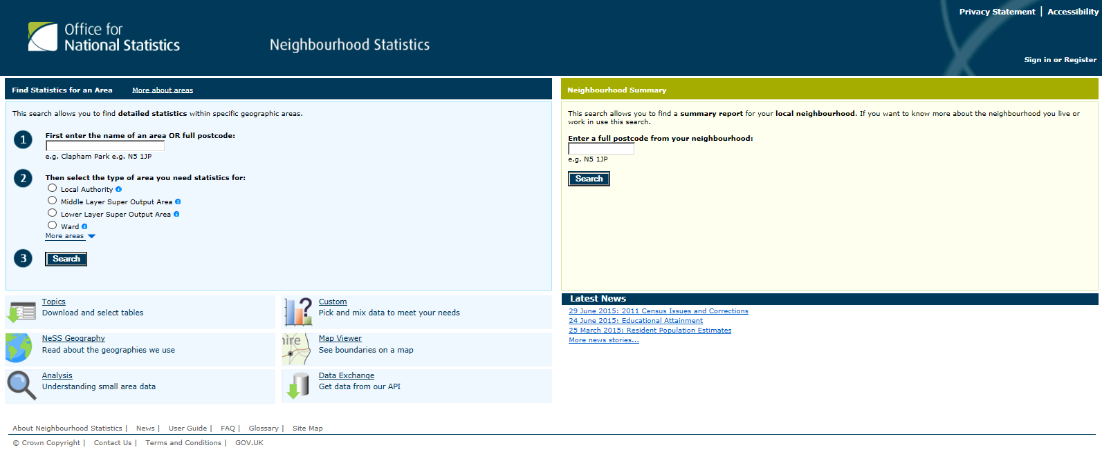
Census data in Neighbourhood Statistics

Slide 9
Step 1: Finding data
In your web browser go to www.neighbourhood.statistics.gov.uk (Internet Explorer tends to work best with this website)

Slide 10
Step 1: Finding data (cont.)
Enter a full postcode from within your area (e.g. AA11 1AA)
Select the geographical scale of the data that you want. (See earlier slide for more information on the different types of area available)
Click ‘Search’ (If this returns more than one result you will be asked to select the correct place on the next page)

Slide 11
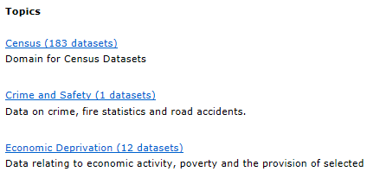
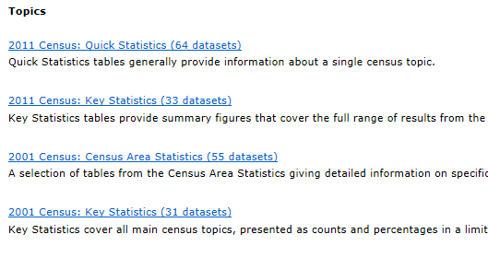
Step 1: Finding data (cont.)
Click ‘Census’
Click ‘Key statistics’ for 2011 (or 2001 if you want more historical data)

Slide 12
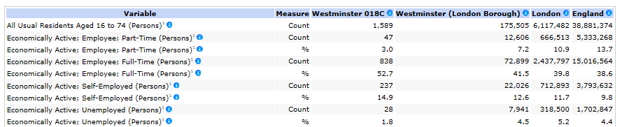
Step 1: Finding data (cont.)
Select a topic from the list on the next page. The topics include economic activity, health, education and housing tenure, among a wide range of others.
This will bring up a table similar to the one shown here, which gives statistics for the area you’ve chosen as well as a comparison with the wider area and rest of the country. For most kinds of statistics it gives a count, i.e. the number of people, as well as a percentage, i.e. the proportion of all residents in the area. Click the blue circles for more information on any of the variables.

Slide 13
Step 1: Finding data (cont.)
You can use this data to make statements about the area. From the highlighted row below you could say “14.9% of the area’s adult population (aged 16-74) are self-employed, compared to 9.8% for the rest of the country.” Try to use percentages where available rather than counts as these are better for comparisons between areas.

Slide 14
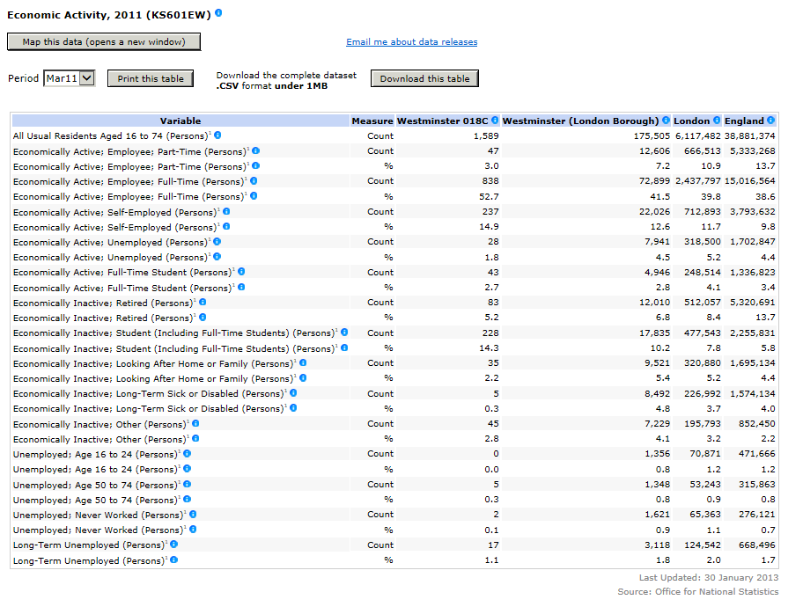
Step 2: Downloading data to use in Excel
Neighbourhood Statistics also gives you the option to download the data to use in an Excel spreadsheet, which allows you to make graphs from the data. Just click the ‘Download this table’ button and save the file to your computer.
Open the file in Excel and you will see a table almost identical to the one online but without the formatting.

Slide 15
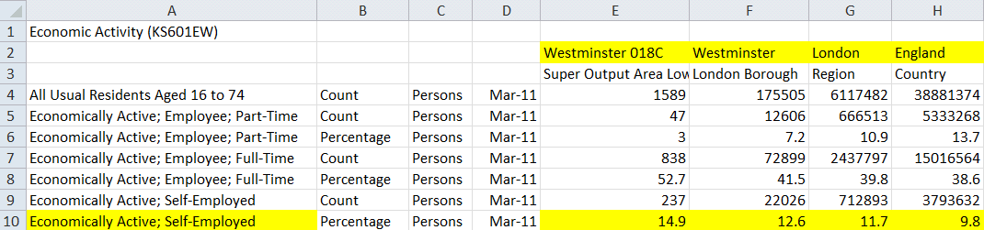
Step 2: Downloading data to use in Excel (cont.)
To make a graph from the data it is often helpful to copy the data you need into a new simplified table. For example, if you wanted to make a graph comparing self-employment across areas from the table on the right you would copy and paste the highlighted cells into a new table as shown here.

Slide 16
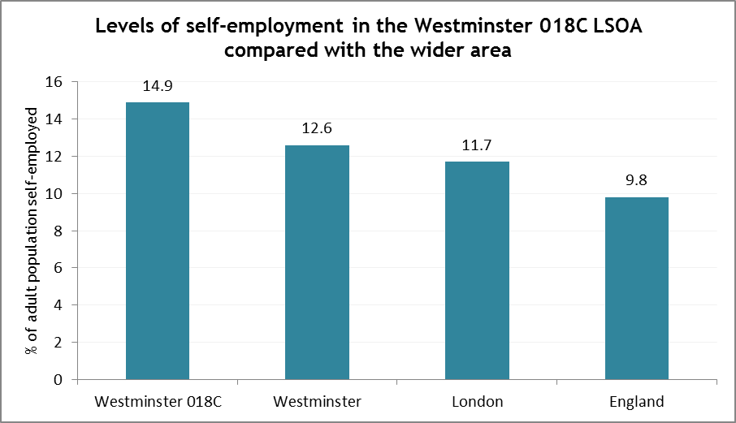
Step 2: Downloading data to use in Excel (cont.)
This new table can then be used to make a graph as shown to the right.
For more information on creating graphs in Excel see this guide: http://www.wikihow.com/Create-a-Graph-in-Excel

Slide 17
Step 3: Mapping local data
If you go back to the website there’s also the option to see how the area compares to other areas nearby by seeing the data on a map.
Just click the ‘Map this data’ button.

Slide 18
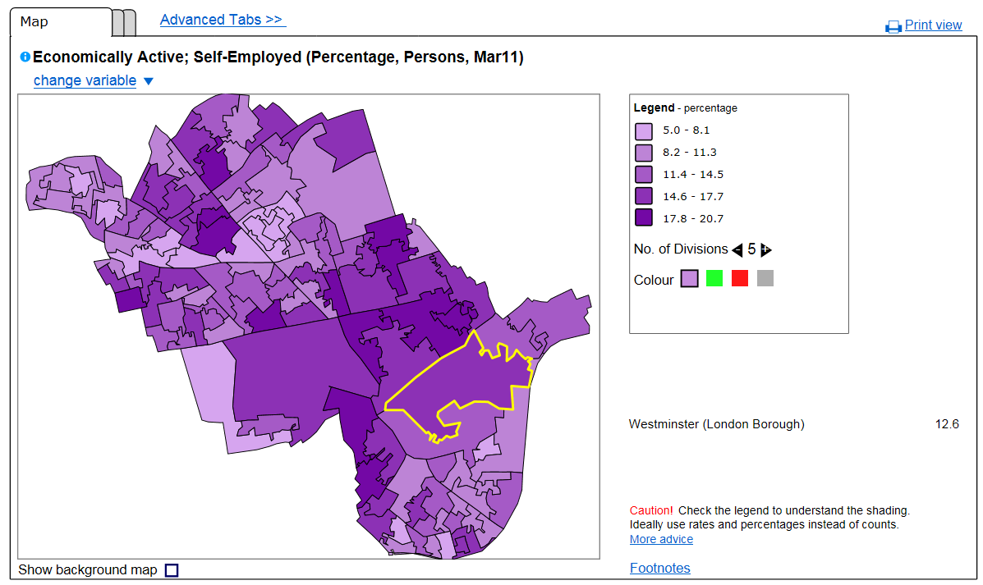
Step 3: Mapping local data (cont.)
This opens a new window which displays a map of the wider area.
Choose the statistical data that you want to map by clicking ‘change variable’.
(Choose percentages rather than counts where possible as this makes it easier to make comparisons between areas; a higher frequency of unemployment, for example, could occur just because an area has more people rather than because there is more of a problem with unemployment.)

Slide 19
Step 3: Mapping local data (cont.)
Change the colour and number of divisions using the buttons to the right of the map.
Choose whether to show a background map using the tick-box at the bottom-left.
To copy the map into another document take a screenshot by pressing Alt+PrtScn on your keyboard and then pasting this into the document (using paste button or Ctrl+V on your keyboard).

Slide 20
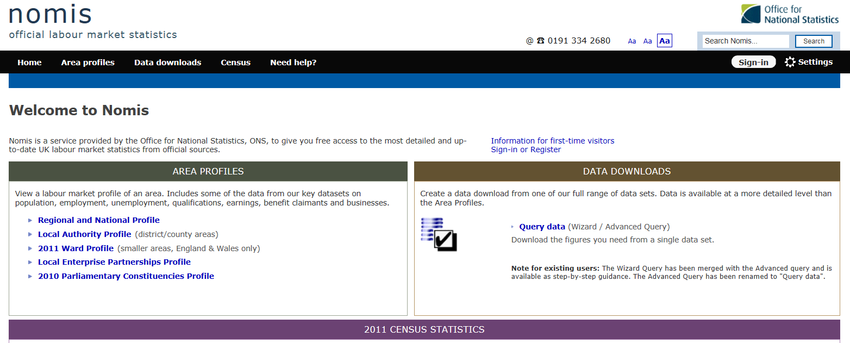
NomisWeb

Slide 21
Using NomisWeb to find local economic data
NomisWeb is a website provided by the Office for National Statistics (ONS) which focuses specifically on labour market statistics. It is especially good for up-to-date data on benefits claimants, but also features a range of Census variables about local economies.

Slide 22
Using NomisWeb to find local economic data
In your web browser go to www.nomisweb.co.uk
Select the scale of area that you would like to see economic data about
(Note that different statistics are available at different scales)

Slide 23
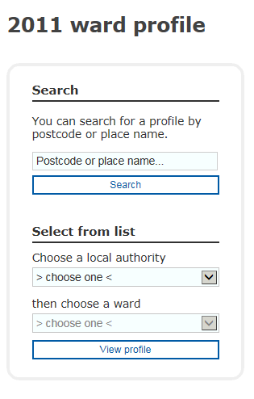
Using NomisWeb to find local economic data
Search for your area using the box on the left-hand side of the page either by typing in a postcode or place name or by selecting your area from a list

Slide 24
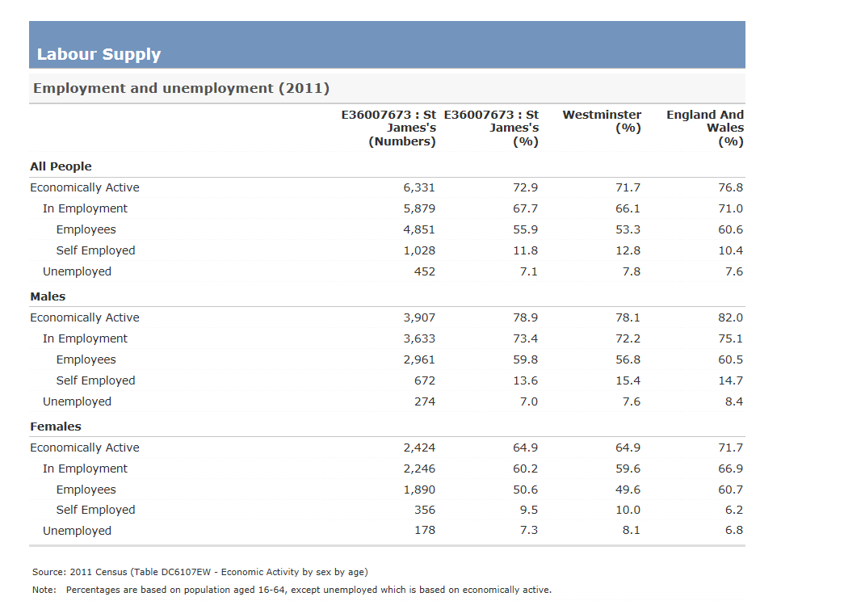
Using NomisWeb to find local economic data
This brings up tables of data about the local area.
These can be used to simply read statistics from or can be highlighted and copied into an Excel spreadsheet to be turned into graphs.
(It is best to paste into Excel without formatting – just copy the table to clipboard by highlighting it and pressing Ctrl+C, go to Excel, right click where you want to place your table and under ‘Paste Options’ select ‘Match destination formatting’.)

Slide 25
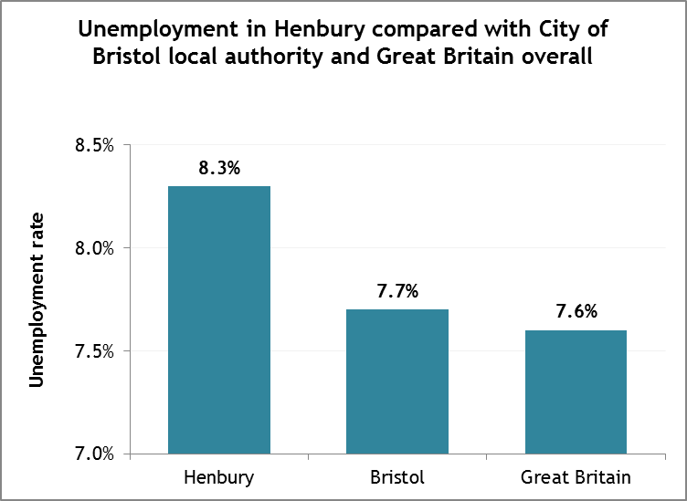
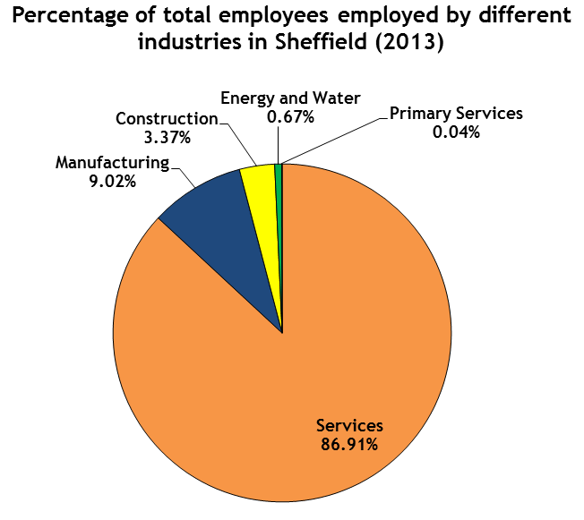
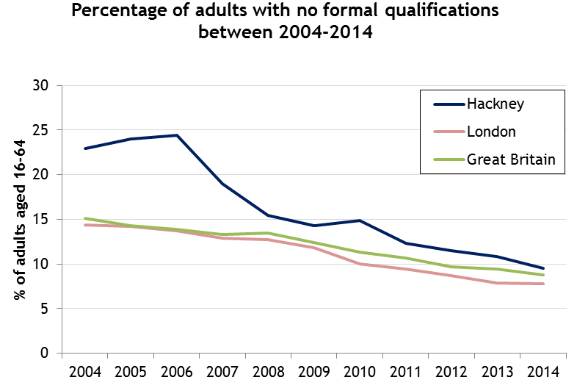
Using NomisWeb to find local economic data
Using the data you could make graphs similar to those shown below. For more information on creating graphs in Excel see this guide: http://www.wikihow.com/Create-a-Graph-in-Excel

Slide 26
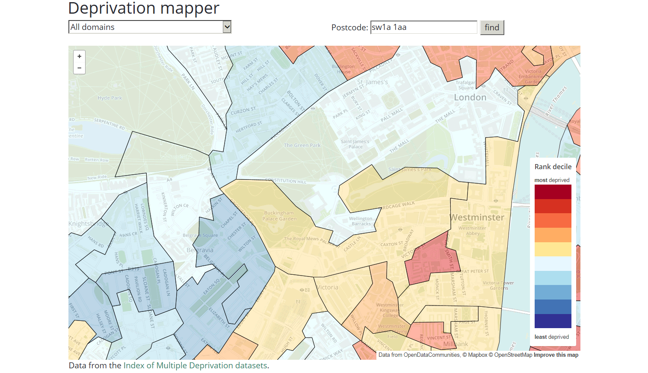
Deprivation Mapper

Slide 27
Using Deprivation Mapper to see deprivation levels in your area
Deprivation Mapper allows you to see how an area ranks on the English Indices of Deprivation, a measure of deprivation which takes into account income levels, levels of employment, health and wellbeing, education and skills, barriers to housing and services, levels of crime and the quality of the living environment in the area.
In your web browser just visit www.opendatacommunities.org/showcase/deprivation and type in your postcode.
Hover over areas to see how they rank in terms of deprivation. (The areas shown are at Lower Layer Super Output Area scale.)

Slide 28
Using Deprivation Mapper to see deprivation levels in your area
If you want to see how areas rank on specific types of deprivation, such as employment, health and disability or crime, then select the drop-down list above the map which currently says ‘All domains’
To take a screenshot of the map just press Alt+PrtScn on your keyboard and then paste it into your document.

Slide 29
Other sources of statistical data
Police.uk – forces across the UK publish local crime data online. Just search for your neighbourhood on https://www.police.uk/ and explore the crime map or view more detailed statistics to see trends over time.
Health Profiles – Public Health England create health profiles for local authorities all over the country which feature a wide range of health data. These can be accessed at http://www.apho.org.uk/default.aspx?QN=HP_FINDSEARCH2012
Local Information Systems (LIS) – some areas have Local Information Systems which pool together a range of local data. Those that exist can usually be found at http://www.data4nr.net/local-information-systems/local/list

Slide 30



mycommunity.org.uk
@mycommunityhelp
#mycommunityhelp
My Community Rights

